Slide 1
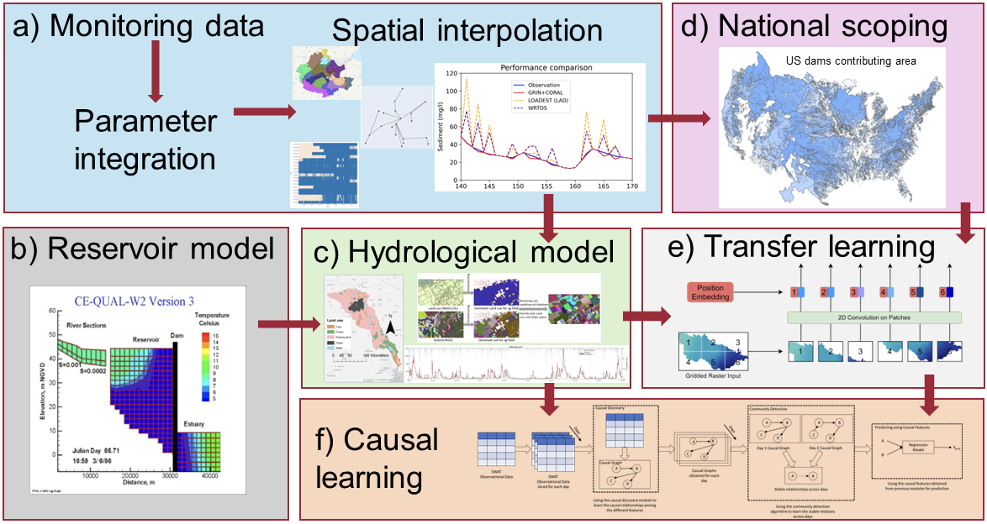
EWN FY24 End of Year In-Progress Review
UPDATE THIS PHOTO
Name of Project: Data Science to Advance Nature-based Solutions for Water Resource Management
Project Code: ERT-ASU-04
PI Name(s): Todd Steissberg, Selcuk Candan, Rebecca Muenich
Funding per FY ($K, add/remove columns as needed)
FY22 | FY23 | FY24 | FY25 | - | TOTAL
$0K | $395K | $200K | $395K |  | $990K

Slide 2
ASU-04: Project Objectives
Our primary objective is to answer this question: “How can we effectively empower decision makers, including USACE and other local water infrastructure managers, to find nature-based solutions that make the most sense for their local context?” This project will achieve its goals through 5 primary objectives:
Developing spatio-temporal causal discovery algorithms and causally-informed, generalizable data and physically-based models of impact for characterizing complex natural and built systems
Developing a scalable and modular cloud-based platform for data and model integration and complex system simulation and emulation
Developing spatio-temporal multi-objective and high-dimensional optimization frameworks
Developing methods to apply transfer learning and emulation modeling techniques to simulate and understand processes driving and controlling integrated NWI and BWI systems.
Implementing, testing, and monitoring the performance of the proposed data frameworks within the context of the three domain PMPs
Notes:
Describe the project objectives as described in the PMP, using a few bullets. Add a couple of project photos. If you’d like to share additional photos, please put these in the last slide of this slide deck.

Slide 3
ASU-04: Research Deliverables
Deliverables | Completed (Y/N) | If no, anticipated date? | Sent to EWN Comms? (Y/N)
Develop spatio-temporal deep learning framework for predicting streamflow | Y |  | Y
Develop STREAMS framework, combining reinforcement learning with LSTM for spatiotemporal causal discovery in streamflow rate prediction | Y |  | Y
Train models for downstream tasks | Y |  | Y
Apply spatio-temporal graph learning for water stream data imputation, developing domain adaptation and diffusion models | Y |  | Y
Developed a general framework for spatiotemporal causal knowledge representation | Y |  | Y

Slide 4
ASU-04: Research Deliverables
Deliverables | Completed (Y/N) | If no, anticipated date? | Sent to EWN Comms? (Y/N)
Validated the SWAT model for causal learning integration | Y |  | Y
Develop causal disentanglement framework | Y |  | Y
Publication: Causal disentanglement | Y |  | Y
Publication: STREAMS | Y |  | Y
Publication: Spatio-Causal Situation Awareness | N |  | N

Slide 5
ASU-04: Project Highlights in FY24
Developed a novel spatio-temporal deep learning framework for predicting streamflow in the Brazos River basin.
Collaborated with Tulane University on research involving spatio-temporal causal learning for streamflow prediction.
Introduced the STREAMS framework, combining reinforcement learning with LSTM for spatiotemporal causal discovery in streamflow rate prediction.
Focused on identifying potential wetlands using datasets like the National Land Cover Database (NLCD), the Soil Survey Geographic Database (SSURGO), and the Height Above Nearest Drainage (HAND) layer.
Trained models for downstream tasks such as flood risk reduction and water storage enhancement, leveraging features like soil characteristics and flood/drainage frequency.
Explored the DataStorm project for simulating traditional hydrological models and enhancing parameter tuning efficiency.
Investigated the use of causal information for improving skyline discovery in decision support queries.
Applied spatio-temporal graph learning for water stream data imputation, developing domain adaptation and diffusion models (https://github.com/keyangds/Domain-Adaptation).
Introduced a causality-aware disentanglement model to improve predictive accuracy in data-scarce regions.
Developed a general framework for spatiotemporal causal knowledge representation to enhance causal discovery algorithms.
Continued wetland prioritization efforts, focusing on adaptive propagation and knowledge transfer methods.
Developed the Causal Streamflow Forecasting (CSF) model, combining station-level runoff predictions with basin-level streamflow learning.
Introduced a weakly supervised causal disentanglement framework to learn generalizable causal representations in noisy data.
Investigated the use of causal learning for efficient Pareto-optimal policy recommendations in decision-making.
Validated the SWAT model for causal learning integration, enabling alternate timeline simulations for hydrological predictions.
Integrated LLM-based soil documentation analysis with data-driven and causal-based learning for wetland prioritization.
Advanced the CSF model for streamflow prediction, incorporating causal graph learning for enhanced accuracy.
Developed a cross-domain time series imputation strategy for missing hydrological data using data-rich regions.
Investigated model integration techniques to unify various hydrological models under a continuous simulation framework.
Established CausalBench for assessing causal learning models with hydrological data, promoting reproducibility and fairness in research.
Notes:
Describe the current project highlights, including major events, activities, deliverables, and/or accomplishments. Include the date of achievement/completion for each highlight.

Slide 6
ASU-04: Project Highlights in FY24
Paras Sheth, Ruocheng Guo, Lu Cheng, Huan Liu, Kasim Selçuk Candan. Causal Disentanglement for Implicit Recommendations with Network Information. ACM Trans. Knowl. Discov. Data 17(7): 94:1-94:18 (2023).
Paras Sheth, Ahmadreza Mosallanezhad, Kaize Ding, Reepal Shah, John Sabo, Huan Liu, K. Selçuk Candan. STREAMS: Towards Spatio-Temporal Causal Discovery with Reinforcement Learning for Streamflow Rate Prediction. CIKM 2023: 4815-4821.
Ting Liu, Qi Deng, Kaize Ding, John L Sabo, Huan Liu, Kasim Selçuk Candan, and Rebecca Logsdon Muenich. Applying Graph Neural Networks to Improve the Data Resolution of Stream Water Quality Monitoring Networks. AGU 2023.
Bilgehan Arslan et al. Streamflow Prediction using SpatioTemporal Deep-Learning based Framework with Reinforcement Learning. HydroML poster, 2023.
F. Azad et al. A Vision for Spatio-Causal Situation Awareness, Forecasting, and Planning. ACM Transaction on Spatial Algorithms and Systems, Under Review, 2023.
Shu Wan, Reepal Shah, Qi Deng, John Sabo, Huan Liu, K. Selçuk Candan. Spatio-temporal Causal Learning for Streamflow Forecasting, accepted for presentation at the N-EWN Symposium, 2024.
P. Mandal, Y. Choi, R. Shah, J. Sabo, H. Liu, K. Selçuk Candan. Identifying Potential Wetlands via Causality-based Data Imputation and Knowledge Transfer, accepted for presentation at the N-EWN Symposium, 2024.
Yoonhyuk Choi, Reepal Shah, John Sabo, Huan Liu, and Selçuk Candan. Prioritizing Potential Wetland Areas via Region-to-Region Knowledge Transfer and Adaptive Propagation, Under Review at CIKM ’24.
Notes:
Describe the current project highlights, including major events, activities, deliverables, and/or accomplishments. Include the date of achievement/completion for each highlight.

Slide 7
ASU-04: Project Highlights in FY24
Shu Wan, Reepal Shah, Qi Deng, John Sabo, Huan Liu, and K. Selçuk Candan. Spatiotemporal Causal Learning for Streamflow Forecasting, Presented as a poster at N-EWN Partner Symposium ’24.
Fahim Tasneema Azad, K. Selçuk Candan, Ahmet Kapkic, Mao-Lin Li, Huan Liu, Pratanu Mandal, Paras Sheth, Bilgehan Arslan, Gerardo Chowell-Puente, John Sabo, Rebecca Muenich, Javier Redondo Anton, and Maria Luisa Sapino. (Vision Paper) A Vision for Spatio-Causal Situation Awareness, Forecasting, and Planning. ACM Trans. Spatial Algorithms Syst. Just Accepted (June 2024). https://doi.org/10.1145/3672556.
Ahmet Kapkiç, Pratanu Mandal, Shu Wan, Paras Sheth, Abhinav Gorantla, Yoonhyuk Choi, K. Selçuk Candan, and Huan Liu. CausalBench: A Transparent Benchmark Framework for Causal Analysis and Machine Learning, Under Review at CIKM ’24.
In review article: Domain-Adaptive Conditional Diffusion Models for Cross-Domain Time Series Imputation. Submitted to AAAI24.
In preparation: Shu Wan, Reepal Shah, Qi Deng, John Sabo, Huan Liu, K. Selçuk Candan. Spatio-temporal Causal Learning for Causally-Guided Streamflow Forecasting.
Accepted for publication: Ahmet Kapkiç, Pratanu Mandal, Shu Wan, Paras Sheth, Abhinav Gorantla, Yoonhyuk Choi, Huan Liu, K. Selçuk Candan. Introducing CausalBench: A Flexible Benchmark Framework for Causal Analysis and Machine Learning. CIKM 2024.
Notes:
Describe the current project highlights, including major events, activities, deliverables, and/or accomplishments. Include the date of achievement/completion for each highlight.

Slide 8
ERT-ASU-04: Status of Project Activities (Thru FY24)
Activity | Deliverable | Comms / Technical Transfer Plan | Lead POC | Original Start Date (MM/YYYY) | Actual Start Date (MM/YYYY) | Original End Date (MM/YYYY) | Actual End Date (MM/YYYY) | Budget ($K) | Percent Complete (%) | Notes
Published.... | Journal Paper | Publication | Candan | MM/YYYY |  | MM/YYYY |  | $0K | 0%
Total |  |  |  |  |  |  |  | $00K | 50%
Notes:
Complete this table for your project. Include all activities and deliverables, including ones that were modified or deleted, as well as ones that were added along the way. Use the notes column to add additional explanation or notes on modifications in the activities, deliverables, or start/end dates.
Use multiple tables/slides if needed.

Slide 9
ERT-ASU-04: Delays and difficulties
The ERDC team’s budget reductions for FY24 required pausing development of an emulator for ERDC’s ClearWater-Riverine water quality model. If funds are available in FY25, this task would leverage the tools and methods developed by the ASU team in FY24.
Notes:
Please include a bullet list of delays and/or difficulties with project activities or deliverables. Indicate how delays/difficulties are being addressed and managed, and the anticipated dates for getting back on track.

